Slide 1
Online College Admission Management System
Project By :
1.Siddhi Rewale
en19330887@git-india.edu.in
2.Priyanka Kadam
en20119587@git-india.edu.in

Slide 2
INTRODUCTION
The project Online College Admission Management System is a web application aimed at carrying out college admission Today all the work at the time of admission of the student is done manually by ink and paper, which is very slow process and consumes manual effort and time. In the modern world of technology, computers are affecting our lives in more ways than we probably are aware of Computerized management maintaining information of an educational institute, colleges, other the list is endless. The main principle behind the need of college admission system is easy supervision of institutes.
The purpose of this project is to build an online college admission management system, a system that reduce lot time of student to follow up on application for a college admission and also help admins to maintain application data effectively In fact, the system consists in u web-portal where students can register themselves on the portal and track entire application process from the web portal itself. Students can update their personal details on the student login portal after they register themselves in the portal and also, they can choose multiple courses in the college giving the priority. Users students can check the result once cut of list is published by the administrators including the cut off marks for each course Moreover, Administrators can add list of college and courses available for registration, they can update the cut oft list for all courses. Administrators can extract the student details from the application, can also extend the application closure time in admin portal. It is a dynamic web application using which students can apply for the different colleges and thereby colleges can allot the seat to the student in their college based on the criteria.

Slide 3
FEATURES & FUNCTIONALITY
The project contains 3 modules i.e. Admin, Student & College. So firstly Admin will register, and login into the system, and firstly he can Add the Courses like B.E, B. Tech, B. Pharm.. etc. After this Admin will Register the Colleges along with the Courses that Colleges have.
ROLES OF USER:
ADMIN ROLE
1) Admin will be able to Register into the System.
2) Admin will be able to Log in to the System.
3) After the Admin login, he can add the Course.
4) After the Admin login, he can Register the College.
5) Add the Course for the College for which Admission is Open.

Slide 4
6) Admin can view all the registered colleges.
7) Admin can view all the Application Forms.
Admin can view all the Application Form which is submitted by the Students.
7) Admin can check the Student allotment status
8) Admin can Download the Application Form with College Allotment Status in PDF format.
9) Admin can Approve the Student Application Form.
STUDENT ROLE
1) Students can Register into the System.
2) Students can log in to the System.
3) Students can register their Application Form.
4) Students can see his Application form.

Slide 5
5) Students can upload Documents if Admin rejects the Documents.
6) Students can Apply to multiple Colleges for Admission.
7) Students can see his Allotment status.
COLLEGE ROLE
1) College can view all the Students who have applied for Admission.The college can see all the applied Students for Admission and the Selected Students in the College. And College can view Student's Application Form.
2) College can Allot the seats to Students.
3) College can Download the Students Application Form with Allotment Status in PDF format.

Slide 6
USED TOOLS AND TECHNOLOGIES:-
i)Software Configuration:-
Project Type:Web Application
Platform: Java
Database:MySQL
Operating System:Windows 11
FrontEnd:Bootstrap
Project Mangement:Maven
Server side Technology:Embedded Tomcat Server,JSP
ii)Hardware Configuration:-
Processor:Core i5
Memory:16 GB
Hard disk:512 GB

Slide 7
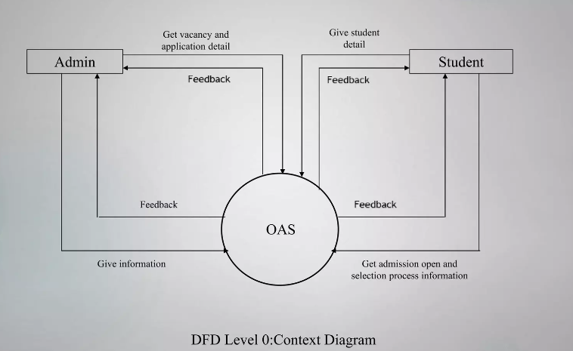
DIAGRAMS

Slide 8
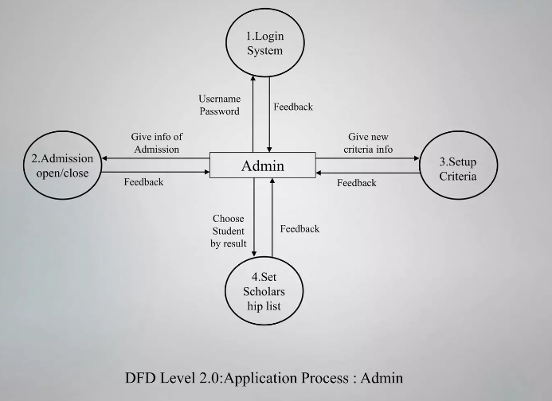

Slide 9
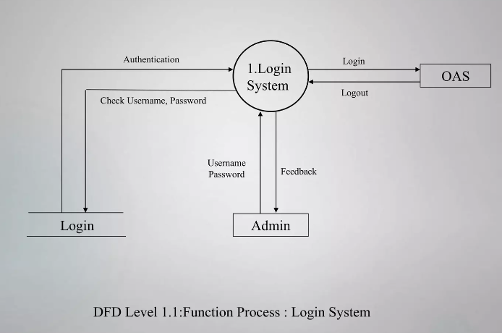

Slide 10
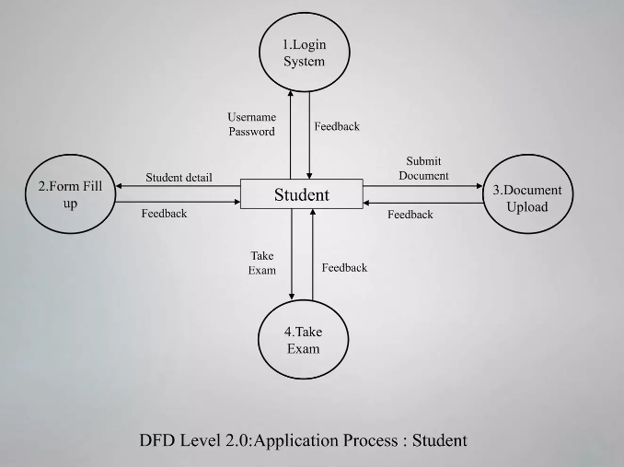

Slide 11
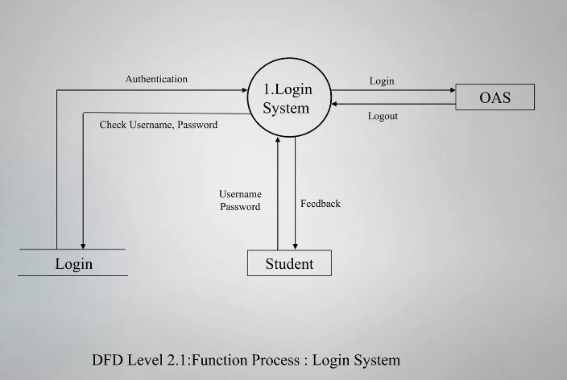

Slide 12
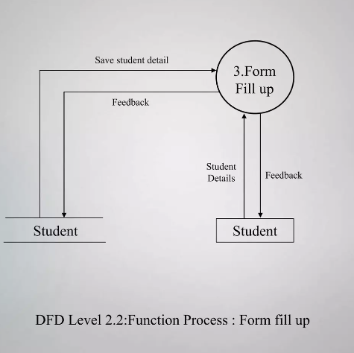

Slide 13
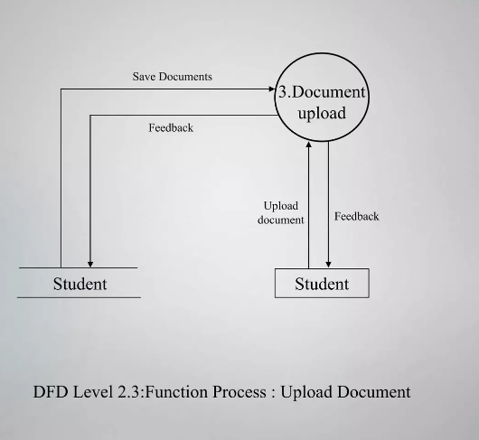

Slide 14
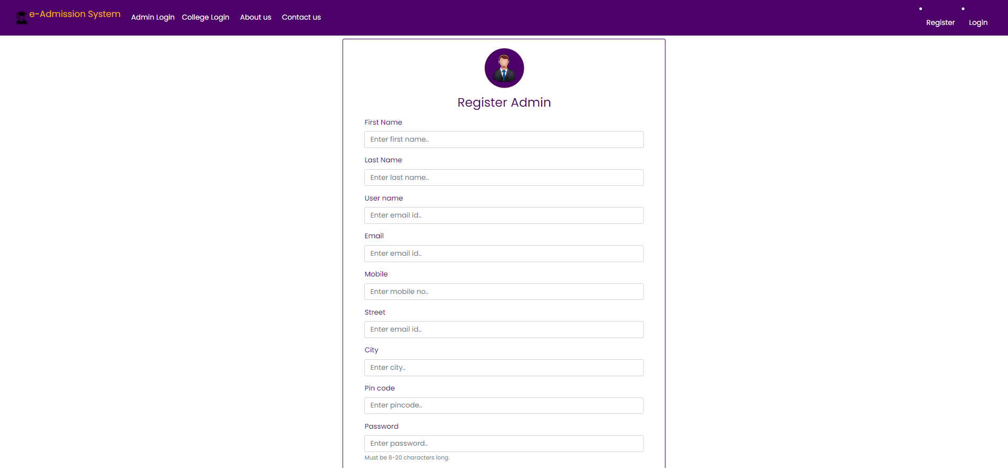
DESIGN AND IMPLEMENTATION

Slide 15
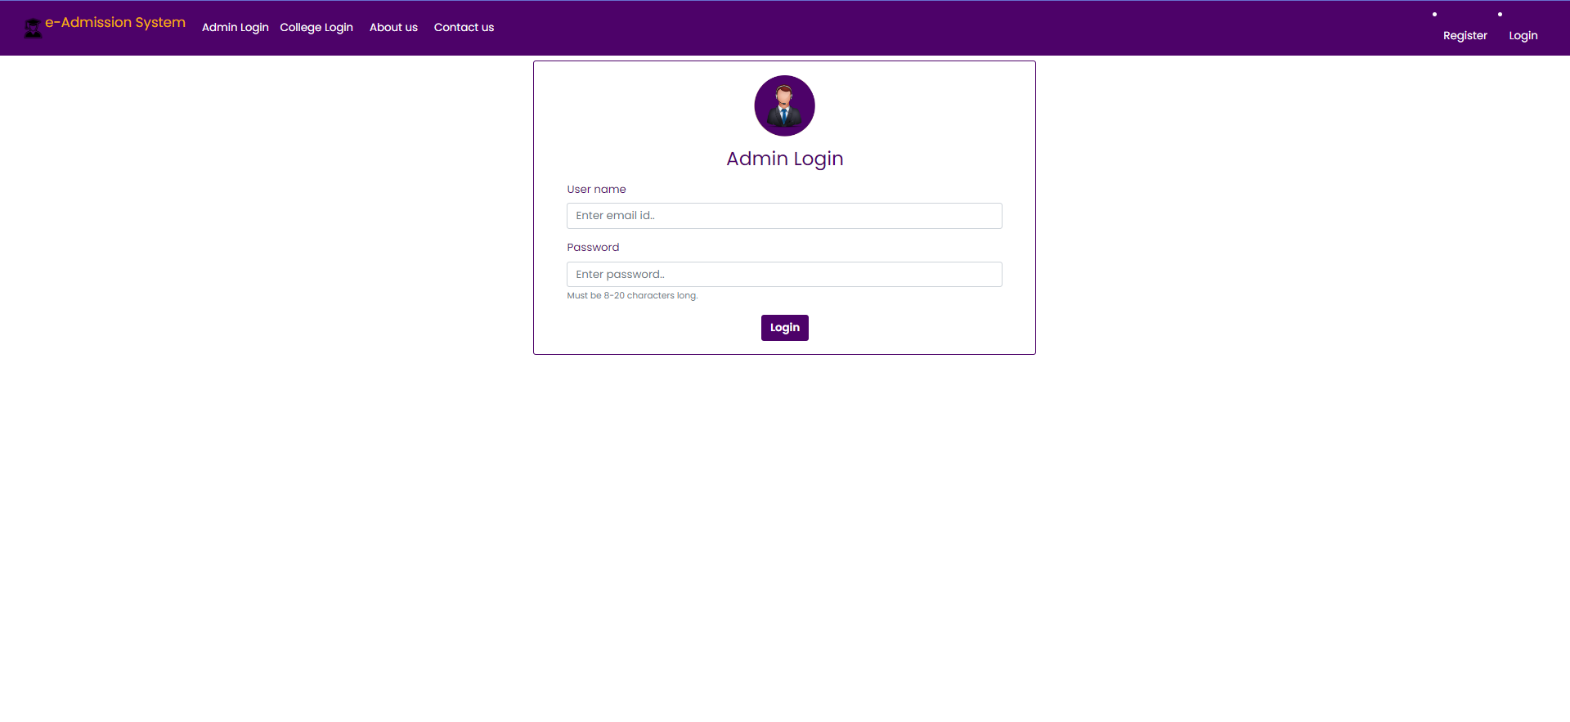

Slide 16
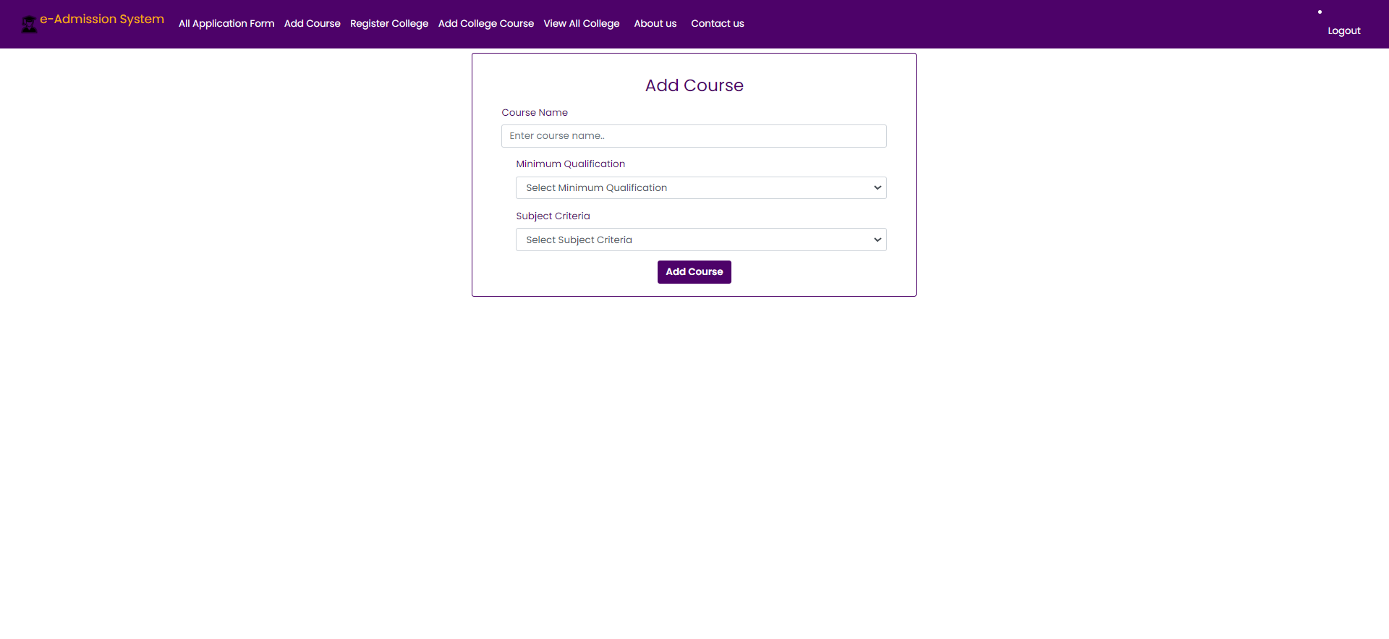

Slide 17
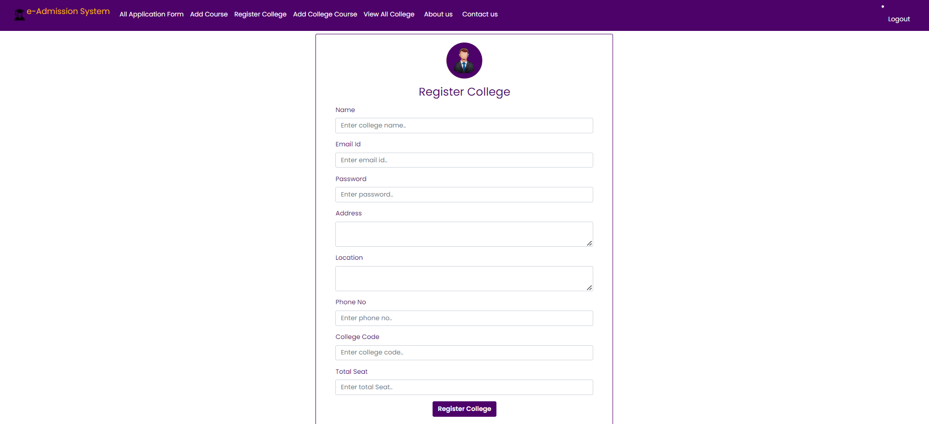

Slide 18
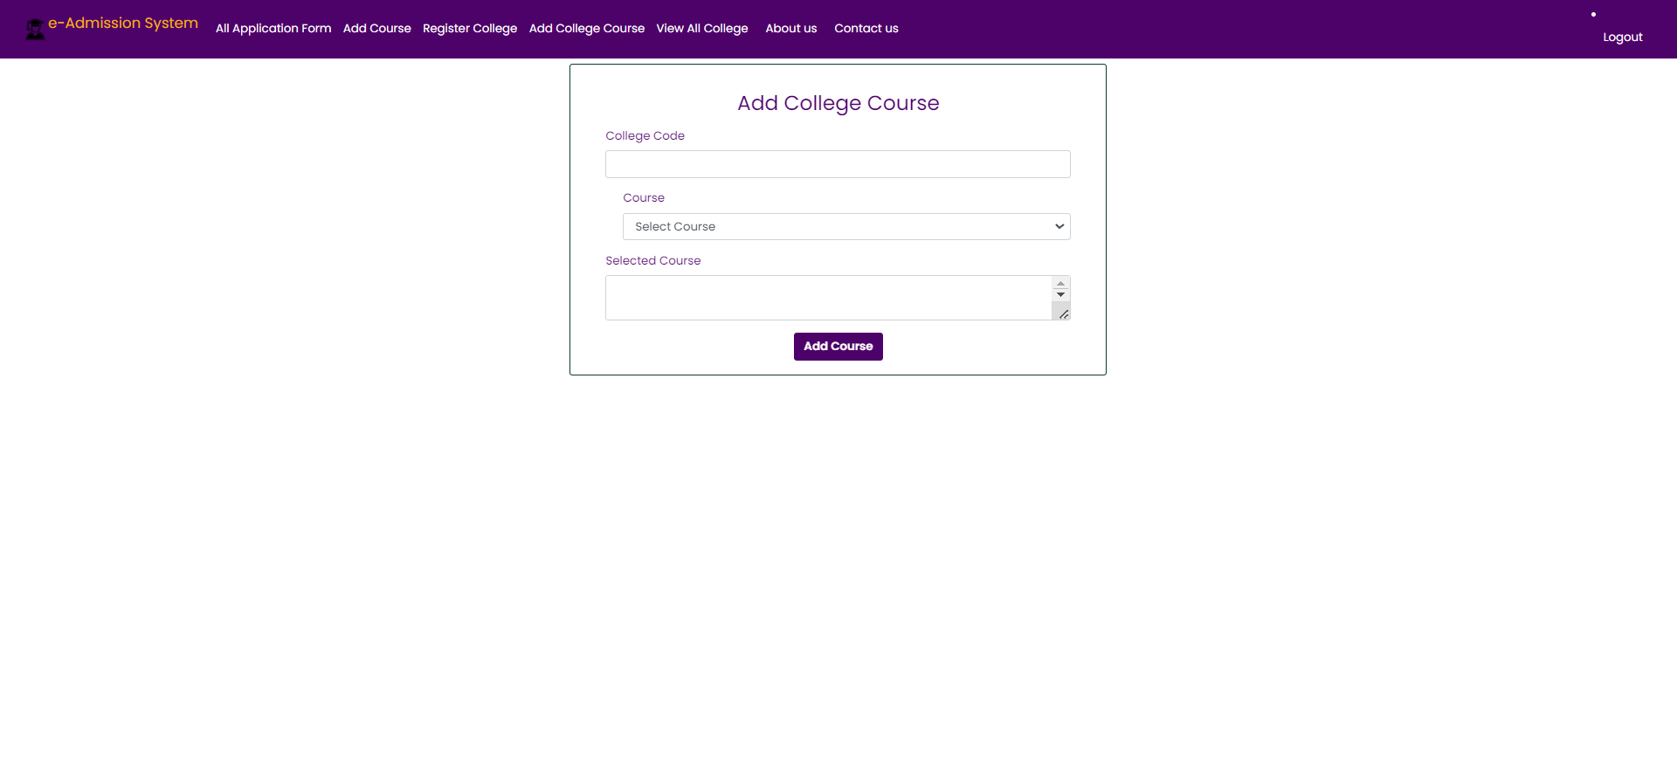

Slide 19
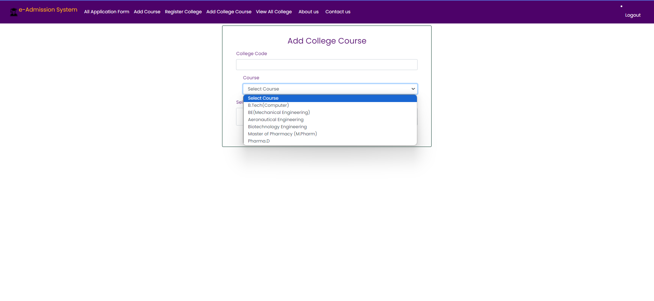

Slide 20
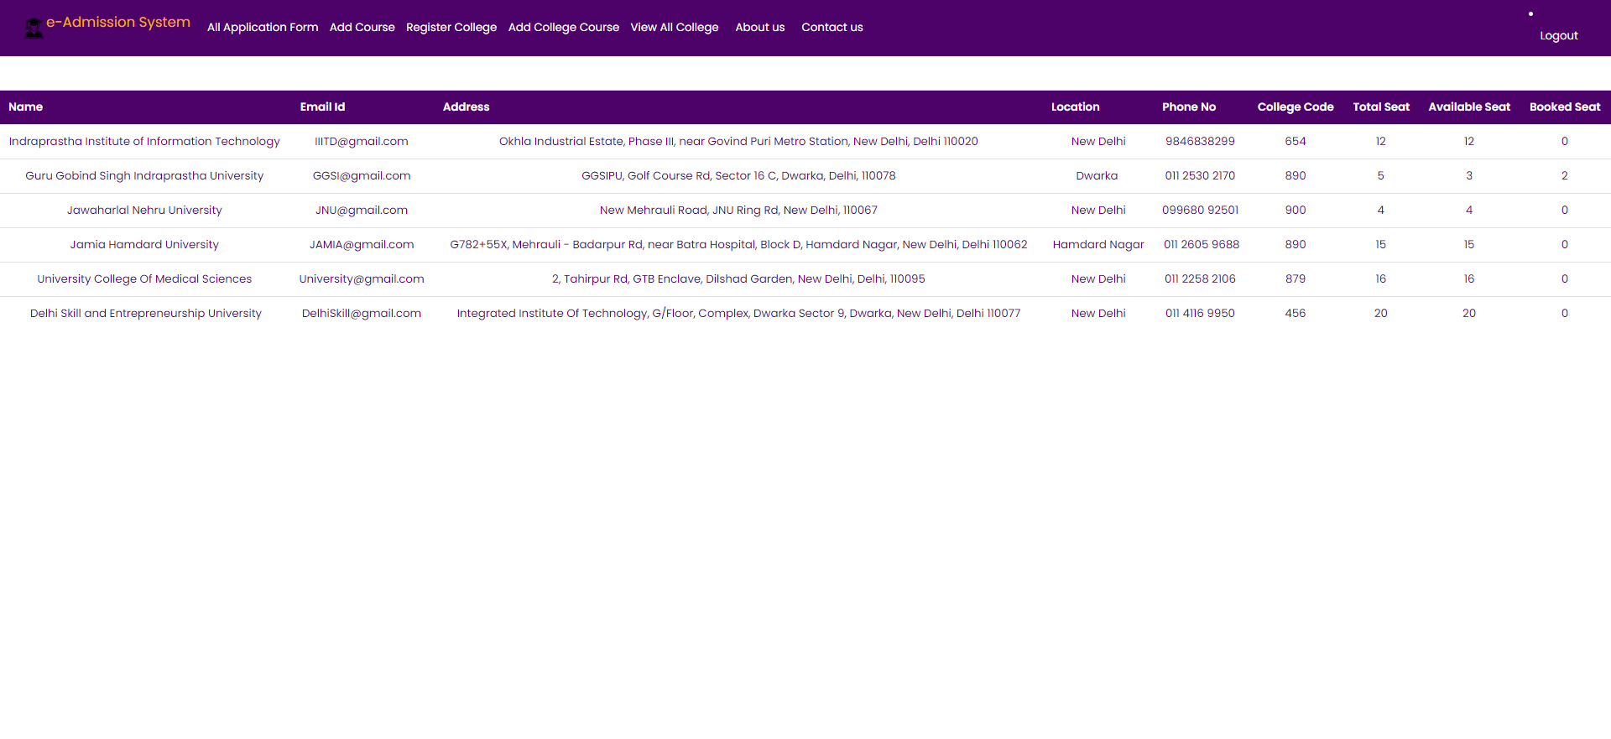

Slide 21
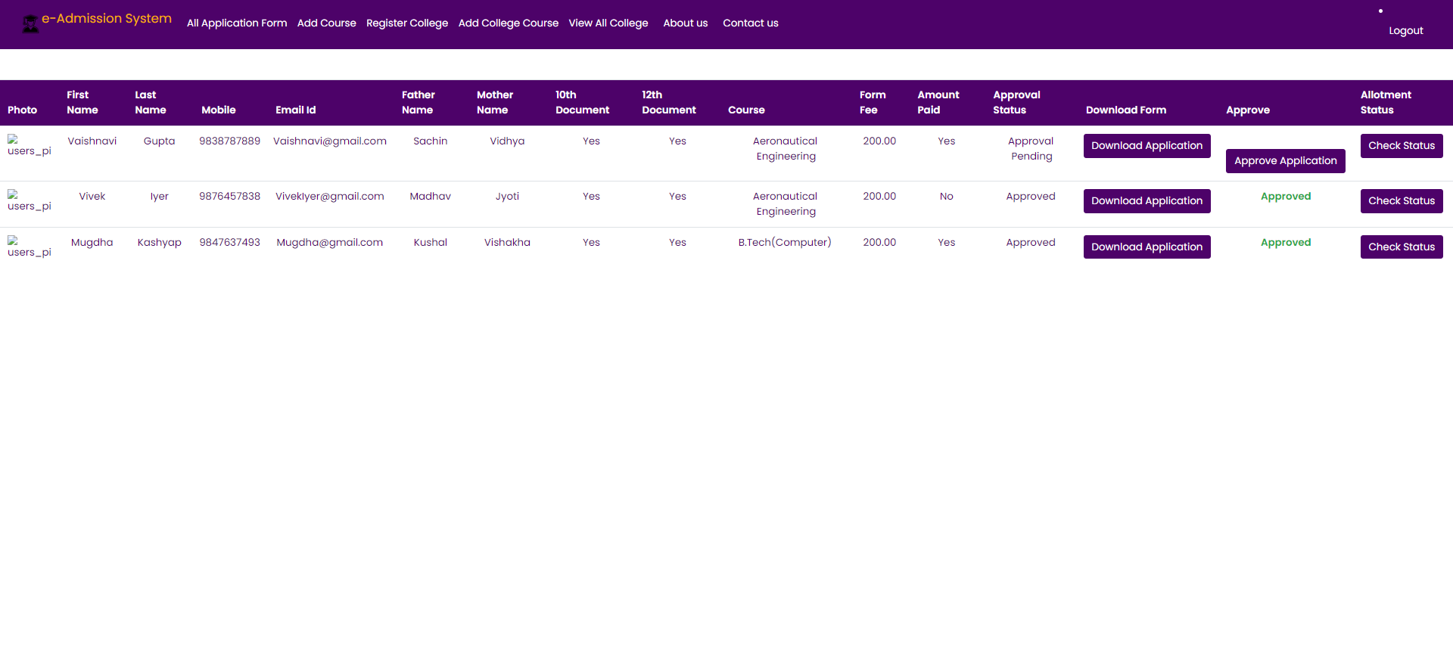

Slide 22
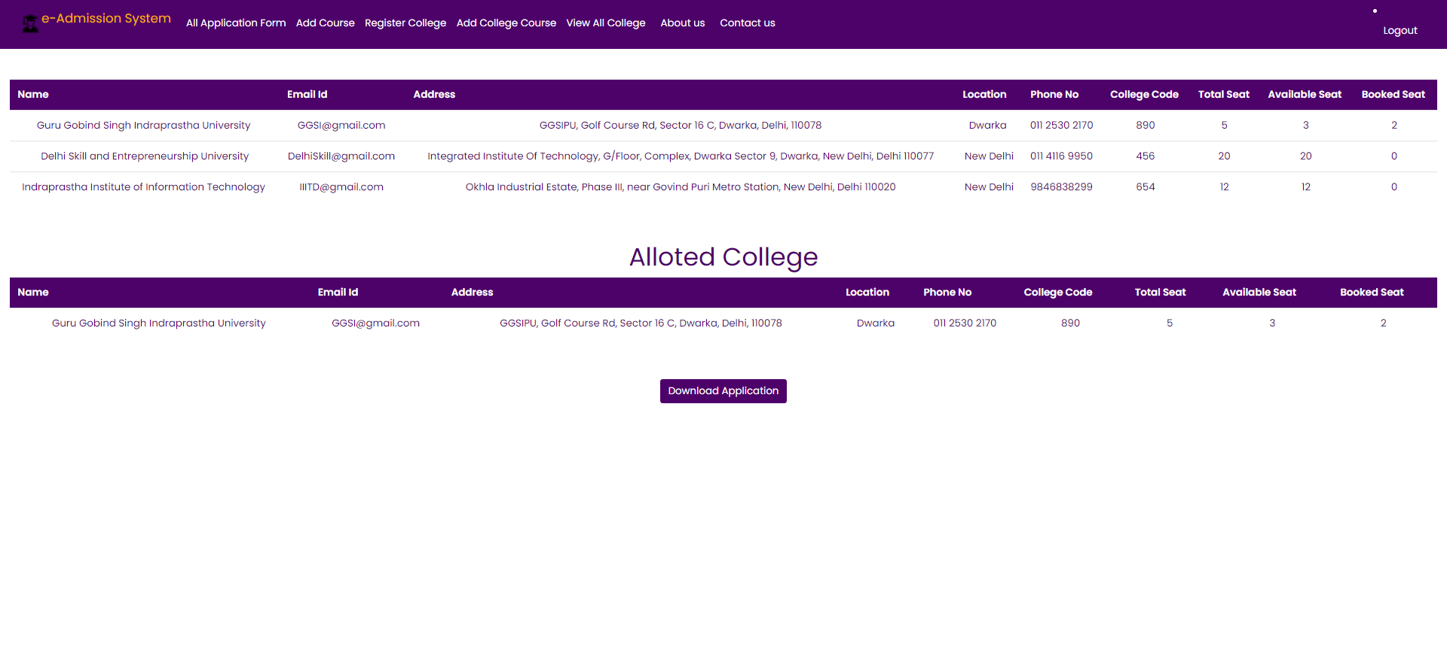

Slide 23
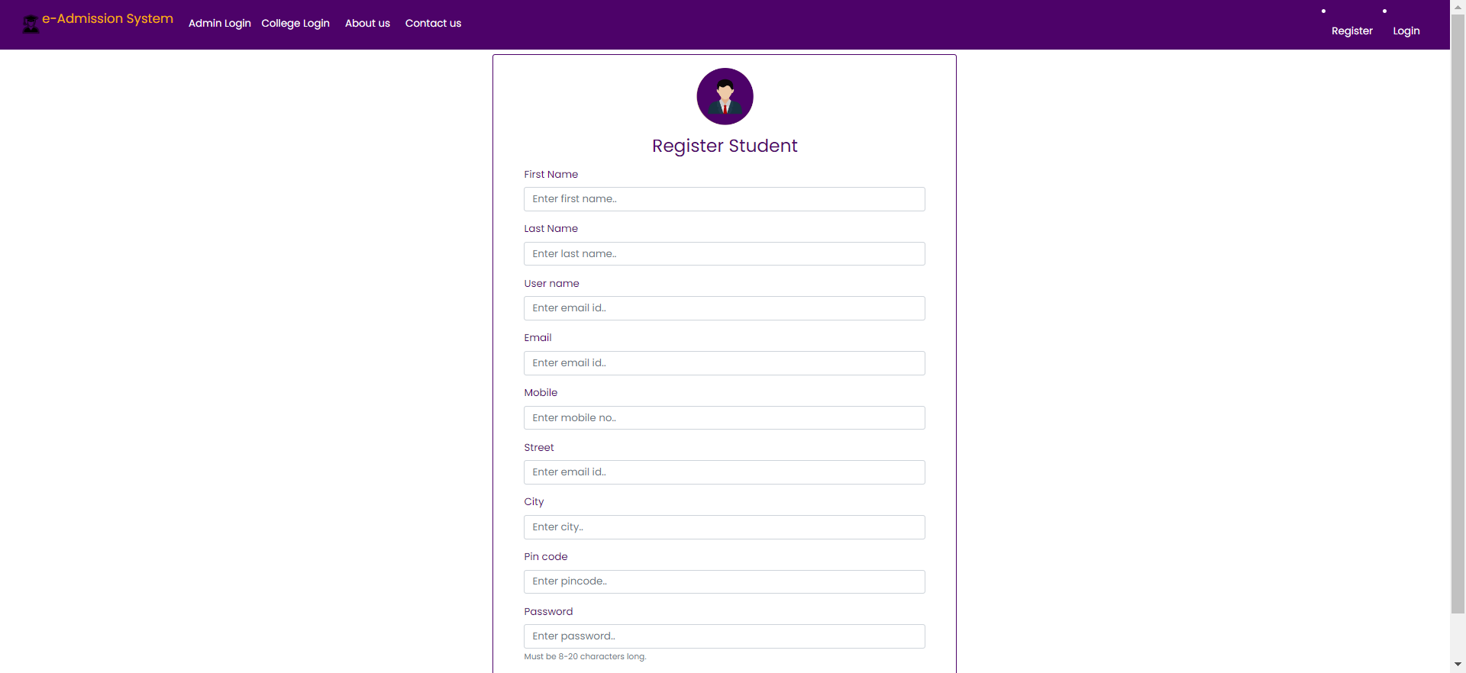

Slide 24
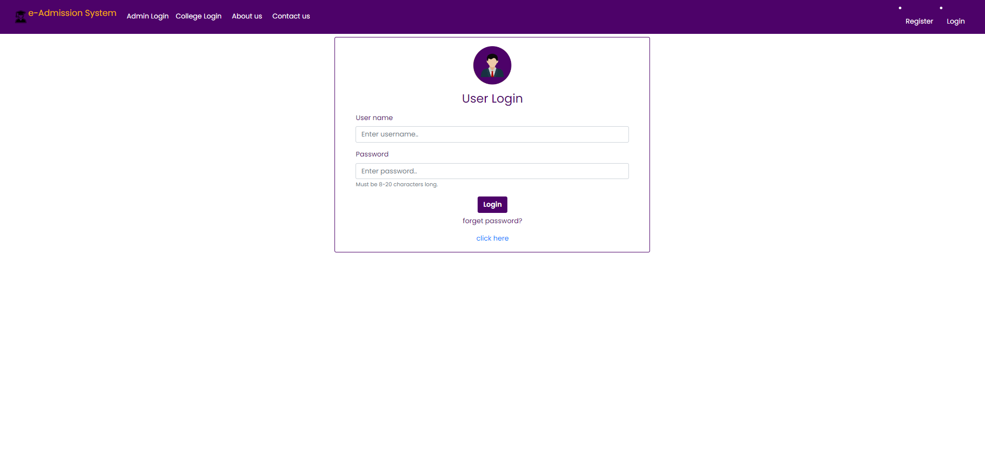

Slide 25
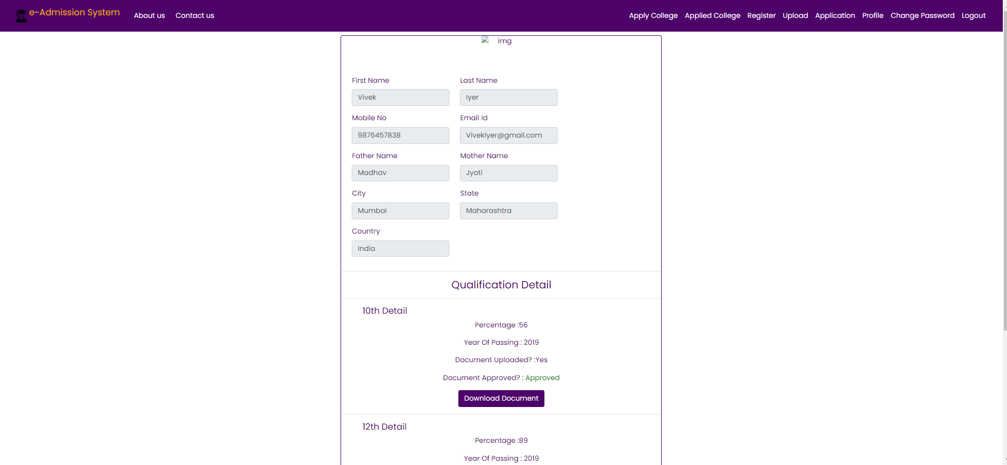

Slide 26
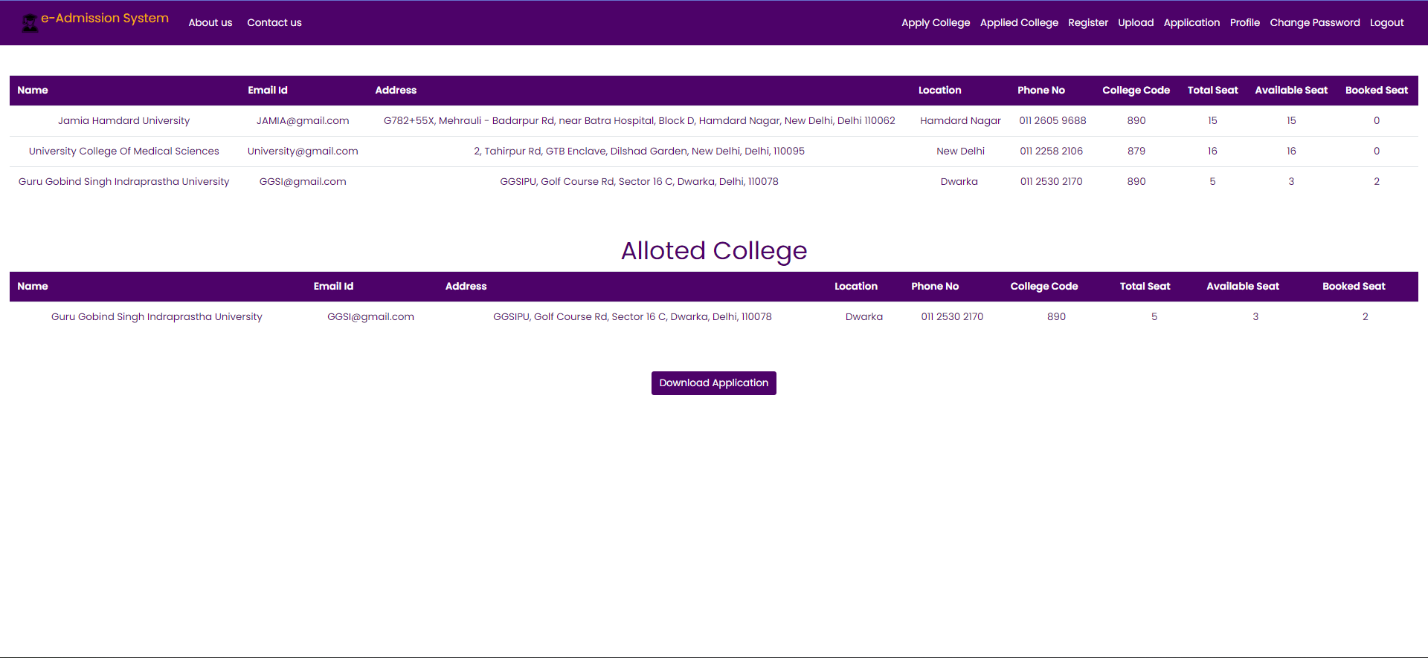

Slide 27
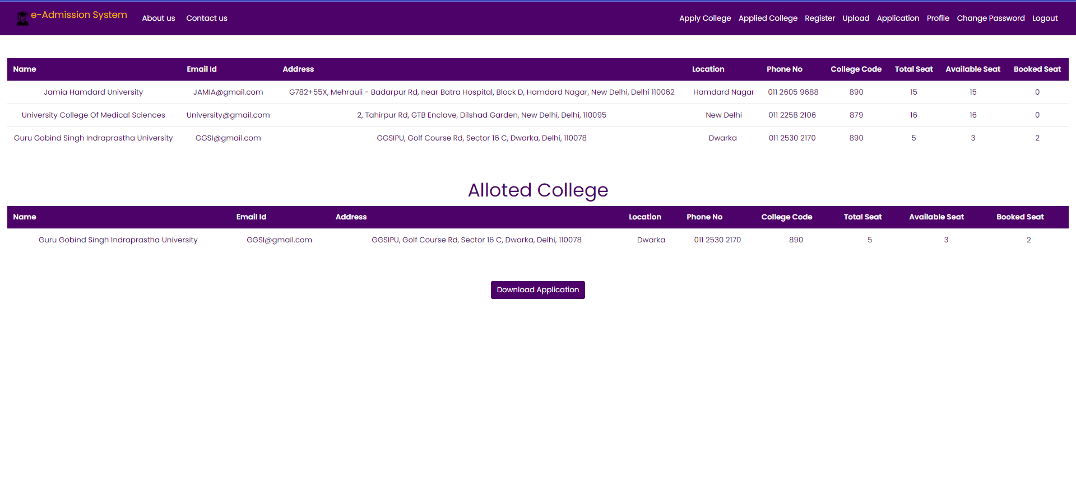

Slide 28


Slide 29
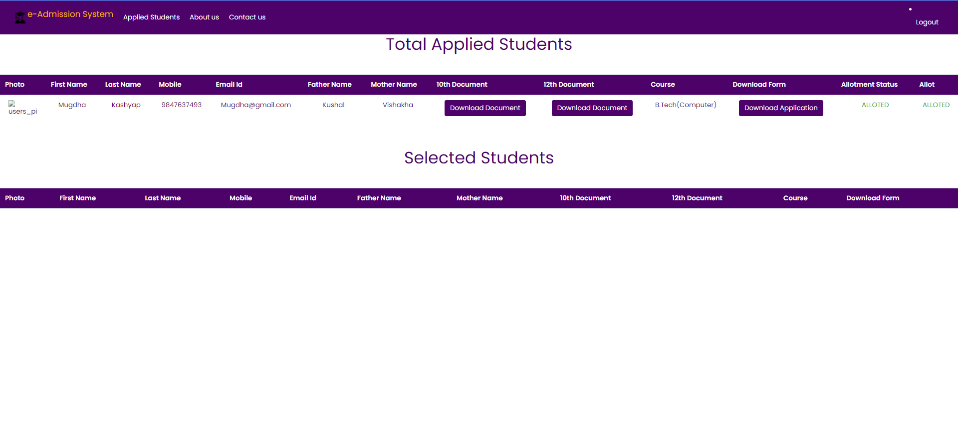

Slide 30
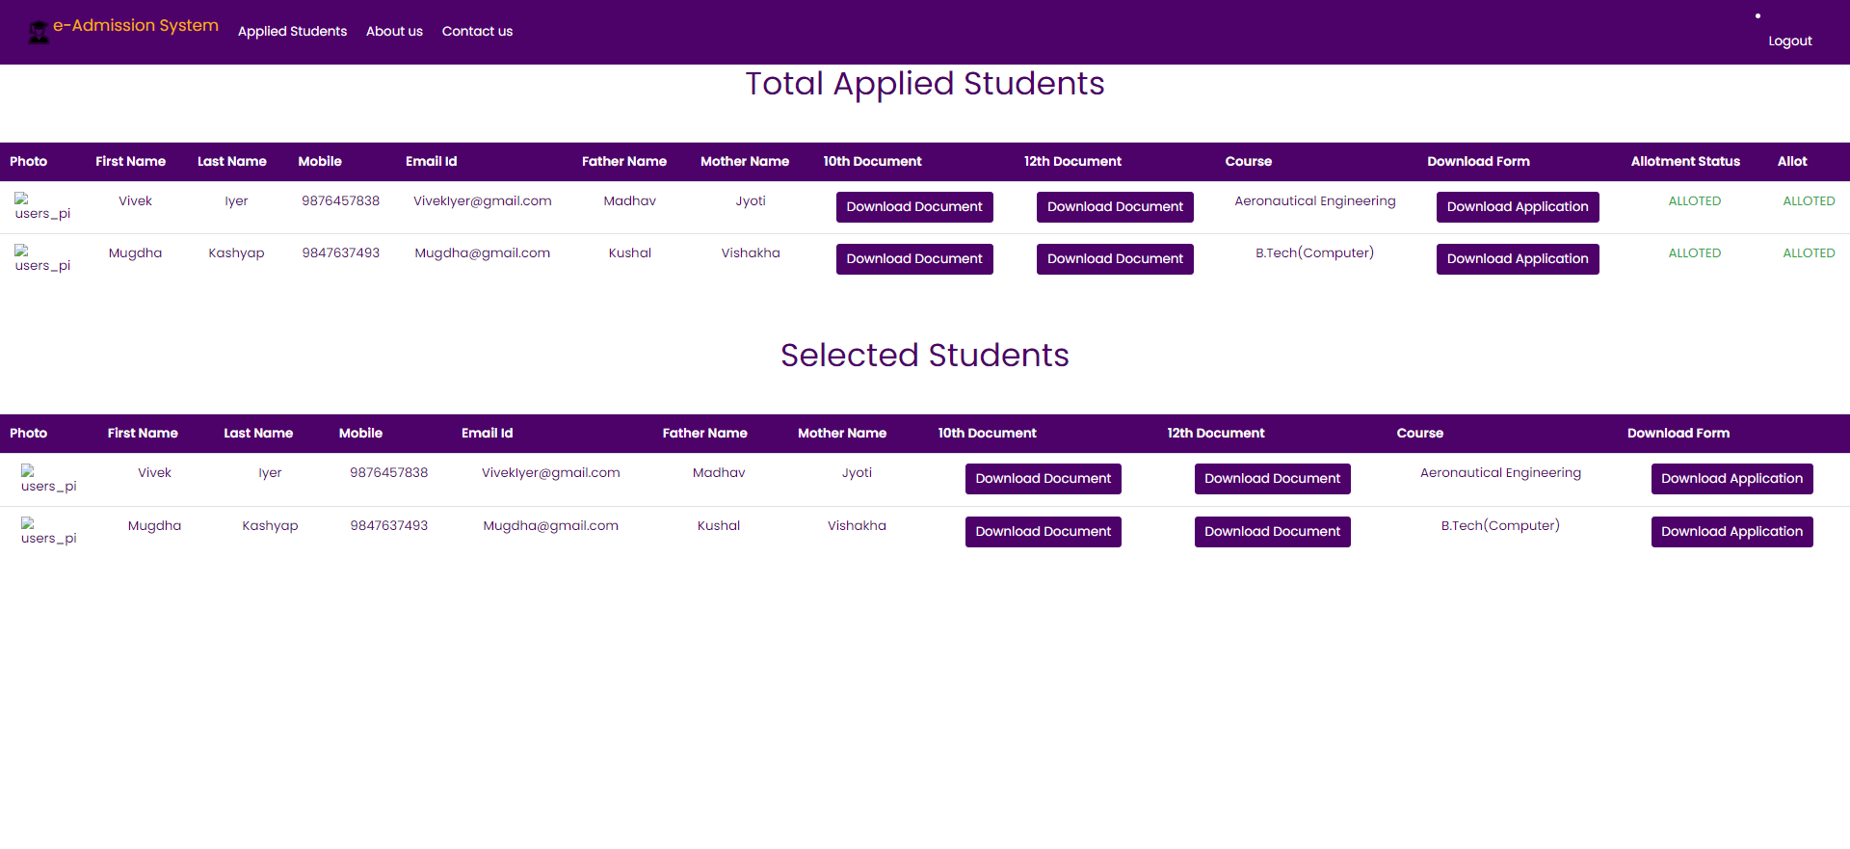

Slide 31
CONCLUSION
In this way we are going to develop college admission system, which is helpful for reduction in manual work so , less manpower required. Student’s record can be access within few seconds , in account section our system focuses on building an efficient and user friendly communication system for the educational institutions.
This project supports the administration team and the applicants with the support needed by making the admission process faster, easier and hassle-free experience for all concerned.

